Slide 1
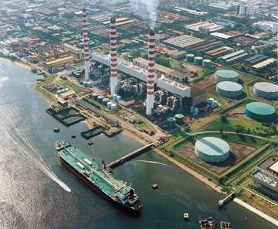
Sainik School Gopalganj
Electricity

Slide 2
What we will Learn…
What is a current?
How to draw electric circuit diagrams
What is potential difference, voltage and E.M.F?
What is resistance?
S/E: Circuits arranged in series versus parallel
S/E: Fixed resistors versus variable resistors
Effects of electric current

Slide 3




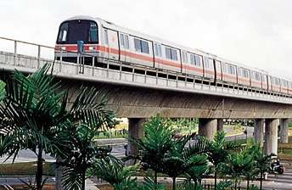



What is Electricity???
Definition:
Electricity is a form of energy that can be easily changed to other forms.

Slide 4
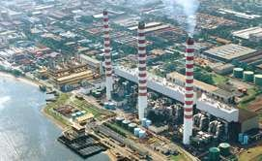

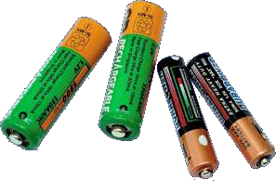
Where does Electricity come from?
Mainly 2 sources:
Power Stations
  Supply a lot of electricity
  Used in many electrical appliances
Electric Cells (batteries)
  Supply a little electricity
  Portable
  Safe

Slide 5





Slide 6














How does an Electrical Appliance Work?
To make an electrical appliance work, electricity must flow through it.
The flow of electricity is called an electric current.
The path along which the electric current moves is called the electric circuit.

Slide 7


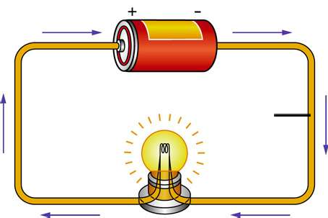
What is an Electric
Current???
electric cell
connecting wire
filament
flow of electrons
Definition:
An electric current is the rate of flow of electric charges in a circuit.

Slide 8
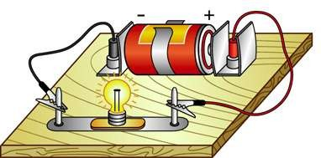
Electric Charges
Electric charges are made up of positive charges (protons) and negative charges (electrons).
When these charges flow in a circuit, a current is produced.

Slide 9
How does electricity flow?
The battery in a circuit gives energy to the electrons and pushes them around a circuit, from the negative terminal of the cell, round the circuit and back to the positive terminal of the cell.

Slide 10

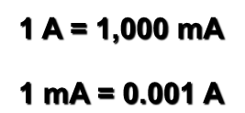


How to Measure Current?
The SI unit for electric current is ampere (A).
Smaller currents are measured in milliamperes (mA).
1 A = 1,000 mA
1 mA = 0.001 A
Different electrical components and appliances require different sizes of current to turn them on.

Slide 11
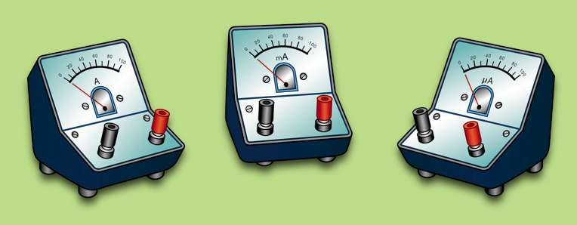

Instrument to Measure Current
An ammeter is an instrument used for measuring electric current.

Slide 12
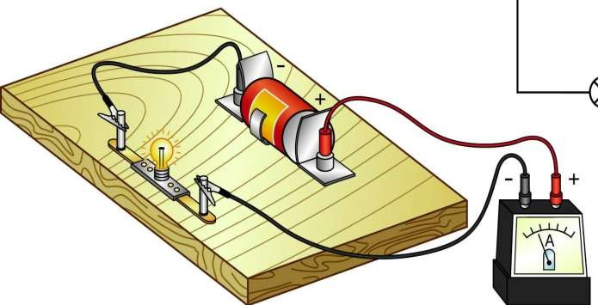
Ammeter
It must be connected in series in the circuit.
Positive side of ammeter must be connected nearest to the positive terminal of the battery (electric cell), and vice versa.

Slide 13




Slide 14






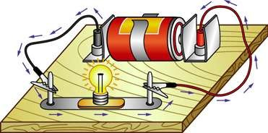












Electric Circuits
Electric circuits are made up of electrical components
These components must be joined together without any gap in between to form a closed circuit.
connecting wires
electric cell
light bulb
circuit board
Note:
Components refer to the light bulb, wires, battery

Slide 15



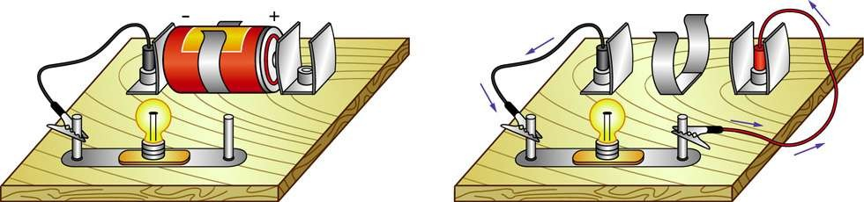
Electric Circuits
Incomplete circuits are called open circuits.
connecting wire is missing
no source of electrical energy
Both the circuits in the diagram are incomplete, hence they are known as “open circuits”.

Slide 16









An electric current flows only when there is:
a source of electrical energy and
a closed circuit
connecting wires
electric cell
light bulb
circuit board

Slide 17













How to draw Circuit Diagrams
Component Symbol Component Symbol
+ +
An electric cell
Battery
Switch (open)
Light bulb (lamp)
Switch
Switch (closed)
Connecting wires (not joined)
Connecting wires (joined)
Symbols are used to represent the various electrical components in circuits.

Slide 18
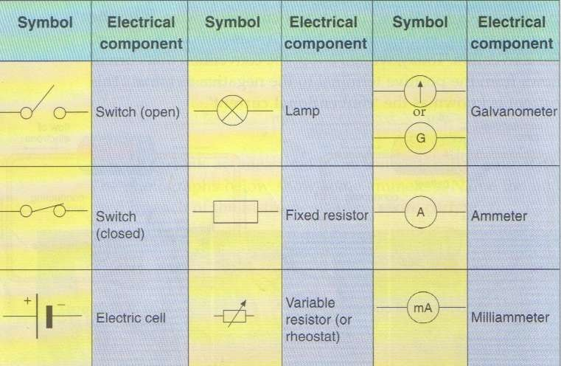

Slide 19

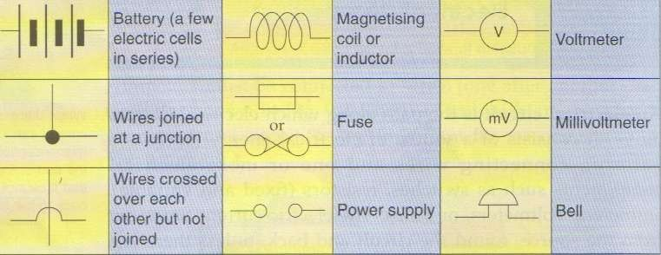

Slide 20

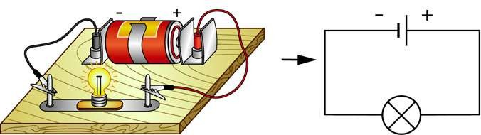

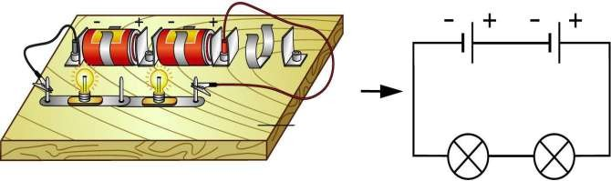
Examples of circuit diagrams:

Slide 21
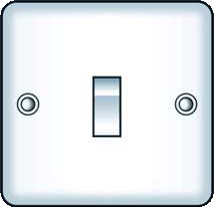

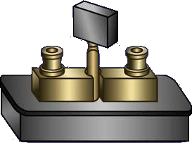
Switches
A switch is used to open or close a circuit.
Main switch used in buildings
Switches used on circuit

Slide 22


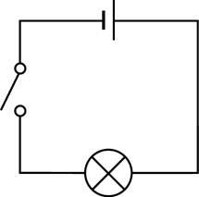
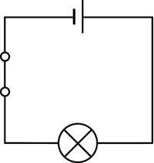
Circuit diagrams for open and closed circuits
Open circuit. Bulb does not light up when the switch is
Close circuit. Bulb will light up when the switch is

Slide 23

Series and Parallel
There are 2 ways in which an electric circuit can be arranged:
Series
Parallel

Slide 24

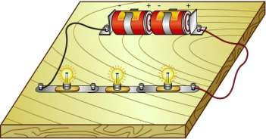
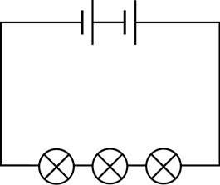
Series Circuit
A series circuit connects the components one after the other
A single loop is formed
A break in any part of a series circuit stops the flow of current in the whole circuit.

Slide 25

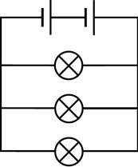
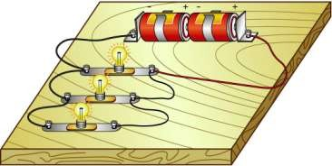
Parallel Circuit
A parallel circuit divides into two or more branches.
The current divides and flows through each parallel branch.
If a component breaks or is removed, the other components remain on.

Slide 26
Which of the following is a series circuit?
Which is a parallel circuit?
Series Circuit
Parallel Cir

Slide 27
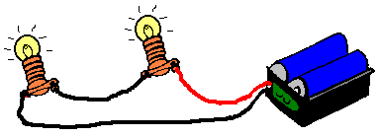
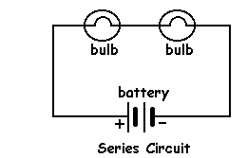
Draw the circuit diagram for the following set up and state whether it is a series or parallel circuit.

Slide 28

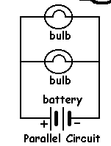
Draw the circuit diagram for the following set up and state
whether it is a seri parallel circuit.
es or

Slide 29
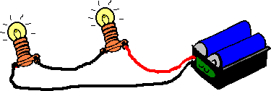
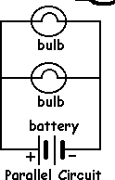
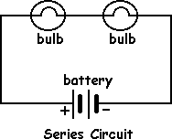
Which is brighter?

Slide 30
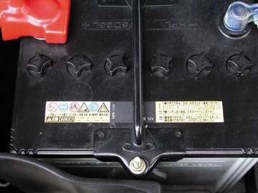

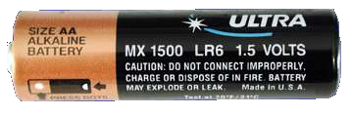

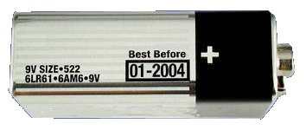

Voltage
An electric cell gives energy to the electrons and pushes them round a circuit. Voltage is a measure of how much energy the electrons receive.
Different voltages are supplied by different cells and batteries.
1.5 V Dry Cell
12 V Car Battery
9 V Dry Cell

Slide 31

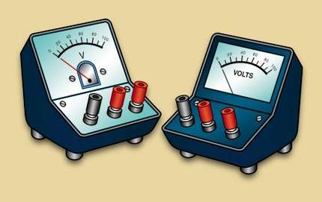
HowtoMeasureVoltage?
The SI unit for voltage is volt (V).
A voltmeter is an instrument use s.
d for measuring voltage

Slide 32
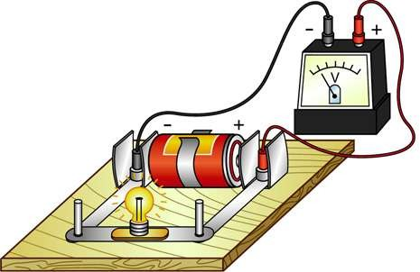
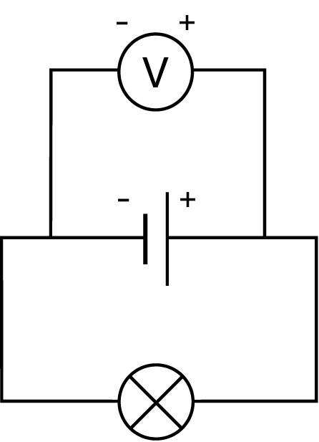
Voltmeter
Voltmeters must be connected in parallel to the circuit.
The positive side of voltmeter is connected to the positive terminal of the cell
versa.
e positive ll, and vice

Slide 33
Recall: Ammeter!!!
It must be connected in series in the circuit.
Positive side of ammeter must be connected nearest to the p
t c
ositive
ic
erminal of the battery (electr ell), and vice versa.

Slide 34







Slide 35
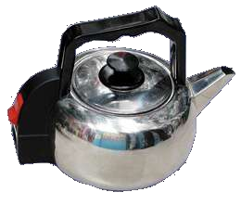
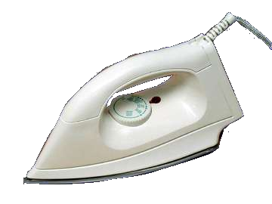




Heating Effect of
Electric Current
When an electric current flows through a wire, the wire heats up. Electrical energy has been converted into heat energy.
The greater the resistance of the wire, the greater the amount of heat produced. This heating effect is used in common electrical appliances.
Iron
Kettle
Hair Dryer

Slide 36
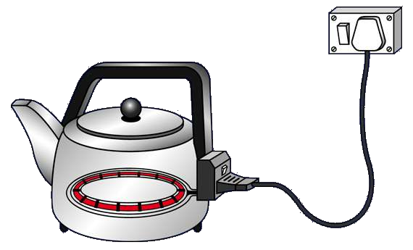

A kettle uses both copper and nichrome wires.
Copper has low resistance while nichrome has high resistance.
Which material, copper or nichrome, should be used for the heating element, and for the external wire?
Use copper wire for the external wire as it has low resistance & produces less heat
Use nichrome wire for the heating element as it has high resistance& produces a lot of heat

Slide 37
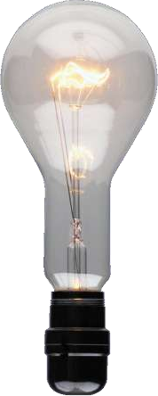
Heating Effect of Electric Current
ARGON (inert/unreactive gas)
filament wire produces
heat and light
In a light bulb, the heated filament which is also a resistance wire, becomes so hot that light is also emitted.

Slide 38
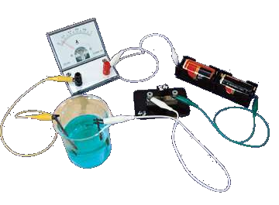
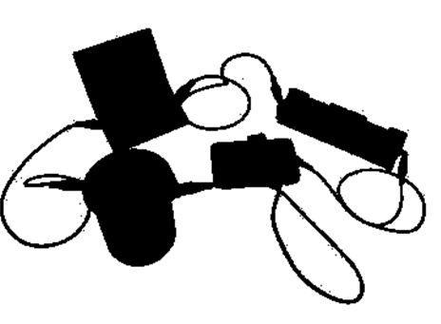
Chemical Effect of Electric Current
What is ELECTROLYSIS?
Definition:
Electrolysis is the chemical change that occurs when an electric current passes through solutions or molten compounds.

Slide 39
Electrolysis
There are 2 uses of electrolysis:
Electroplating
Extraction of Metals

Slide 40
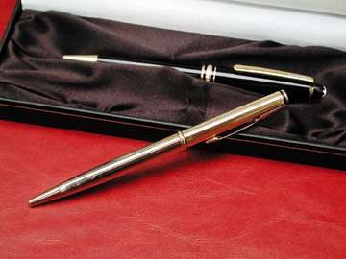

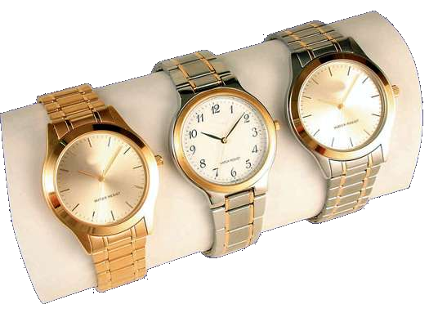

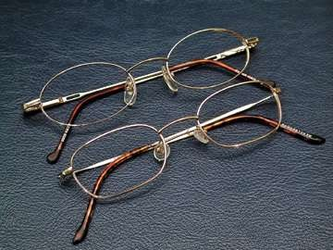

Uses of Electroplating
Metal objects can be plated with a
thin layer of another

Slide 41
2. Extraction of metals
Some metals (eg. sodium, aluminium) are obtained by electrolysis.
To extract the metal
  heat the solid compound of the metal until it melts
  pass an electric current through the molten
compound

Slide 42
Differences between an electromagnet and a magnet:
Electromagnet | Magnet
A temporary magnet which can be turned on and off using electric current. | A permanent magnet which retains magnetism until it is purposely demagnetised (spoilt).
Magnet can be made stronger or weaker | Magnet remains the same strength

Slide 43
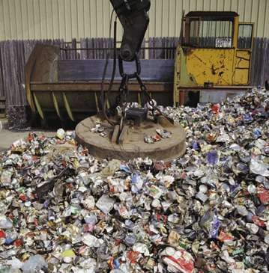

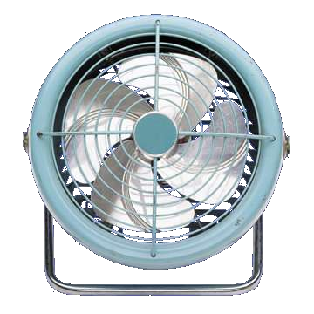
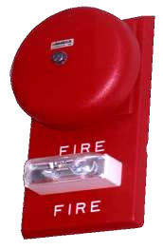


Uses of Electromagnets
Cranes that lift iron/steel
Iron/steel separators
Electric bells
Magnetically
crane
levitated trains
_{Ele} Electric bell _{otors}
•
ctric m
Electric motor in fans

